Slide 1
HCI : Labs

Slide 2
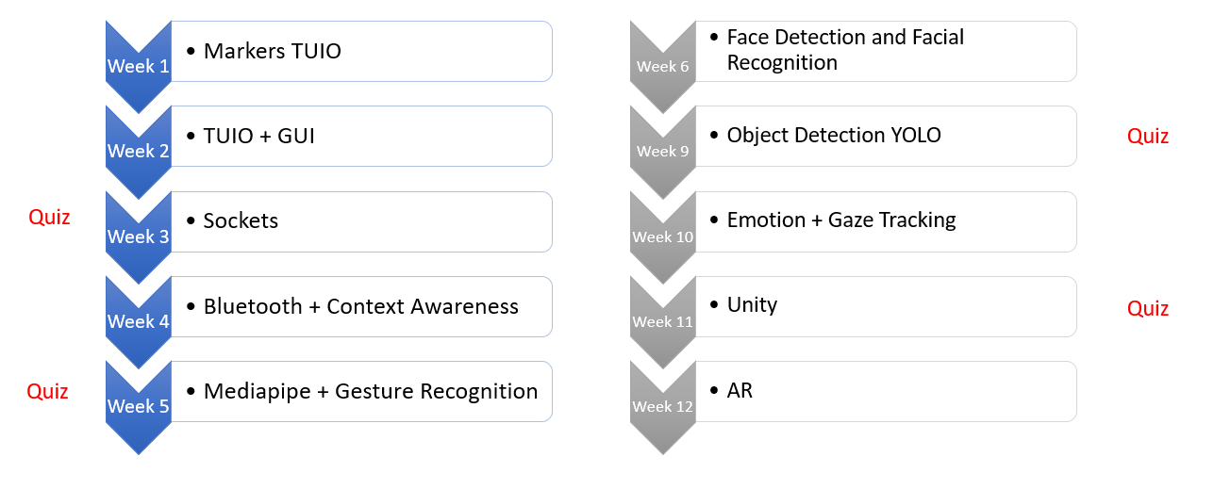
ROADMAP

Slide 3
Socekts
What is sockets?
Applications
File transfer applications
Instant messaging applications
Online games
Chat applications
Peer-to-peer networking applications
Internet of Things (IoT) applications
Notes:
https://realpython.com/python-sockets/

Slide 4
Sockets: Applicatoins

Slide 5
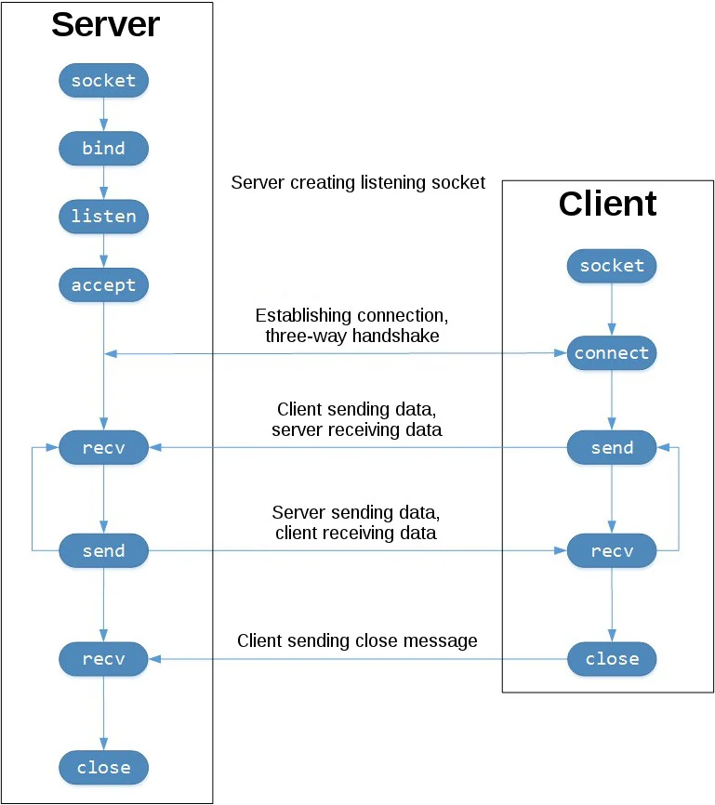
Sockets Architecture

Slide 6
Threading
What is Threading
Multi-Threading Vs. Multi Processing
Synchronous Vs Asynchronous

Slide 7
Threading

Slide 8
Multi-Threading VS. Multi-Processing

Slide 9
Sync Vs. Async

Slide 10
Thrading

